Slide 1
Music generation with Diffusion models
Bojescu Mihai, 2025

Slide 2
Agenda
Short history
Data representations
Existing work
Proposed solution

Slide 3
Short history

Slide 4
Pre computers era
Precomputed, randomly-aligned bars
Example: Mozart Dice Game, 1787
The parts were composed by an artist ahead of time
Each and every part was composed such that it was sound with the other ones
Generation was done by rolling a dice and selecting the parts indicated by it
Example: Pick part 5, then 8, then 11, then 17

Slide 5
Early computers era
Rule-based systems
Example: David Cope (1987). Experiments in music intelligence. University of California.
Markov chains and Genetic algorithms
Example: de Mantaras, R. L., & Arcos, J. L. (2002). AI and Music: From Composition to Expressive Performance. AI Magazine, 23(3), 43. https://doi.org/10.1609/aimag.v23i3.1656

Slide 6
Modern computers era
Neural Networks, with different architectures:
  GANs
  VAEs
  RNNs
  Transformers
  Diffusion models

Slide 7
Data representations

Slide 8
Data representations
Partitures, piano rolls
Grammars, MIDIs
Waveforms
Spectrograms, mel-spectrograms

Slide 9
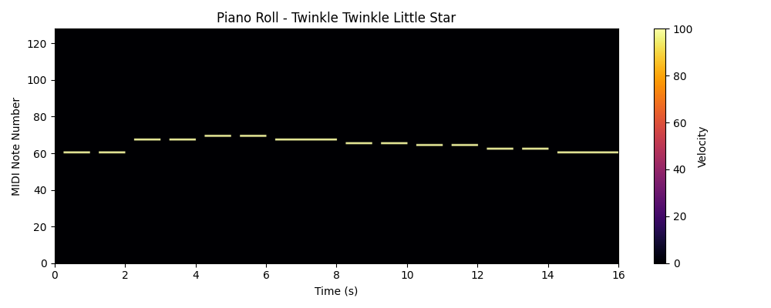
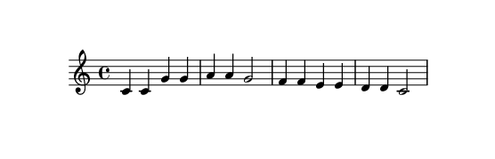
Partitures, piano rolls

Slide 10
Partitures, piano rolls
Built by artists as blueprints for music, based on music theory
Can express tempo, pitch, energy of one or more instruments
Can be processed by computers after preprocessing
Can be used by ML algorithms
Cannot express the imperfections of the music intepreter if interpreted by a computer program

Slide 11
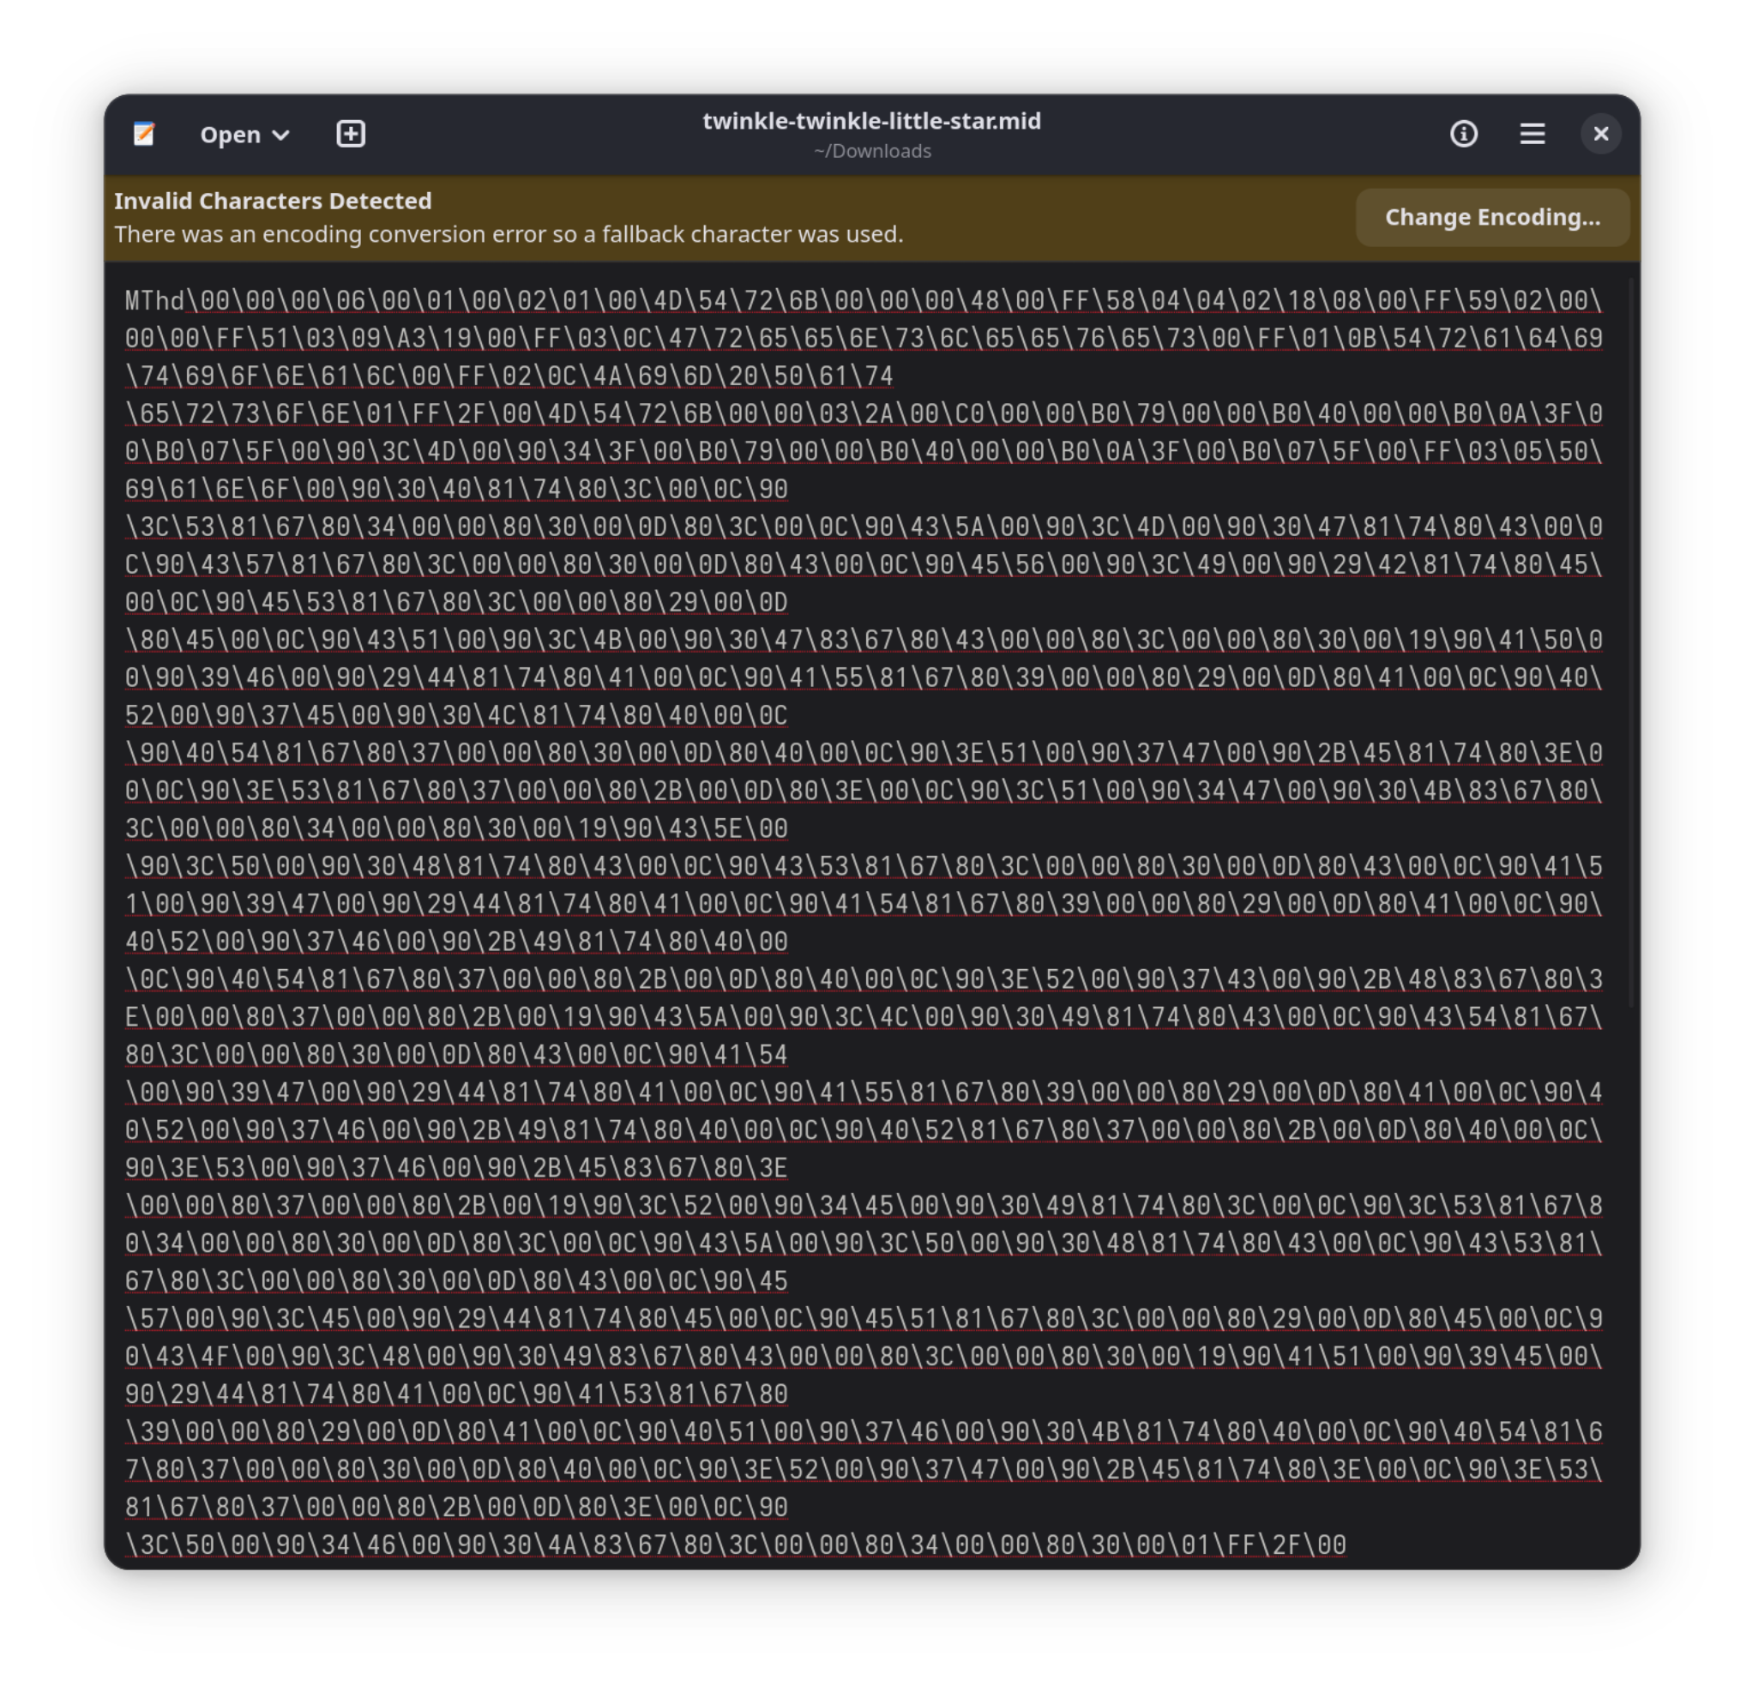
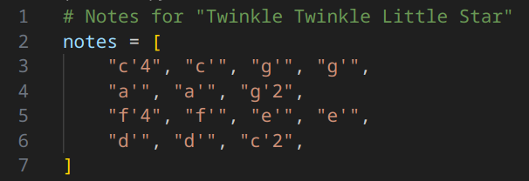
Grammars, MIDIs

Slide 12
Grammars, MIDIs
Represent another way to represent musical partitures. They are more specific to computers rather than artists
Can express tempo, pitch, energy of one or more instruments
Can be processed by computers after preprocessing
Can be used by ML algorithms
Cannot express the imperfections of the music intepreter if interpreted by a computer program

Slide 13
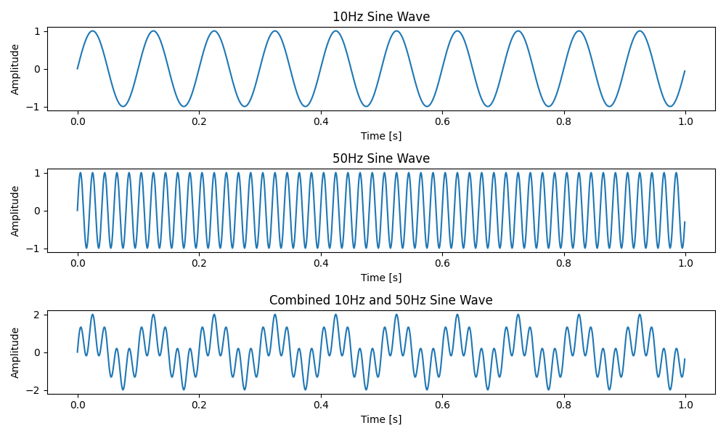
Waveforms

Slide 14
Waveforms
Represent the way the medium vibrates in order to produce the music
Can express any sound, doesn’t need to follow music theory
Example: speech
Can express tempo, pitch, energy of one or more instruments
Can express the emotion of the artist
Can be processed by computers after processing
Often used by ML algorithms

Slide 15
Waveforms

Slide 16
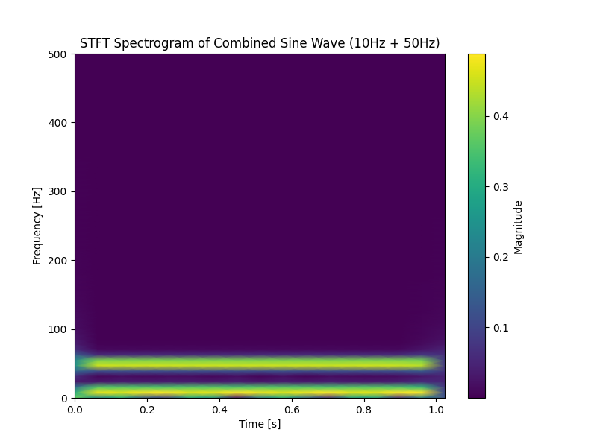
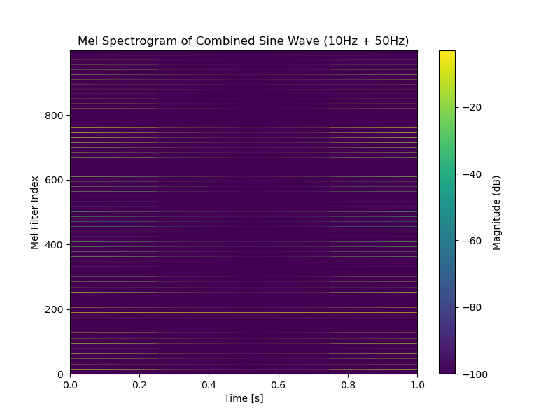
Spectrograms, mel-spectrograms

Slide 17
Spectrograms, mel-spectrograms
Created by applying Fourier transforms on a waveform in order to extract the frequencies and their contribution from it
Can express tempo, pitch, energy of one or more instruments
Can express the imperfections of the interpreter
Can be processed by computers after processing
Often used by ML algorithms

Slide 18
Existing work

Slide 19
MuseGAN
Architecture: Generative-adversarial networks, with CNN generators and CNN discriminators
Priming data: Noise
Output data: Multi-track piano rolls

Slide 20
MuseGAN
The MIDIs are categorised, filtered and merged:
  The MIDIs are split into the following 5 categories: bass, drums, guitar, piano, strings & other. The ones that are not in any of these categories are discarded
  The MIDIs that have only a few notes are merged with MIDIs of similar instruments, in order to prevent data sparsity
    Even if this introduces noise, the authors preferred it instead of empty bars
  The MIDIs that are not in 4/4 time and don’t have the “Rock” tag are discarded
  Example: Pink Floyd – Money gets discarded due to being in 7/8 time, even if it is a “Rock” song, with the categories above
The MIDIs are then transformed into piano rolls

Slide 21
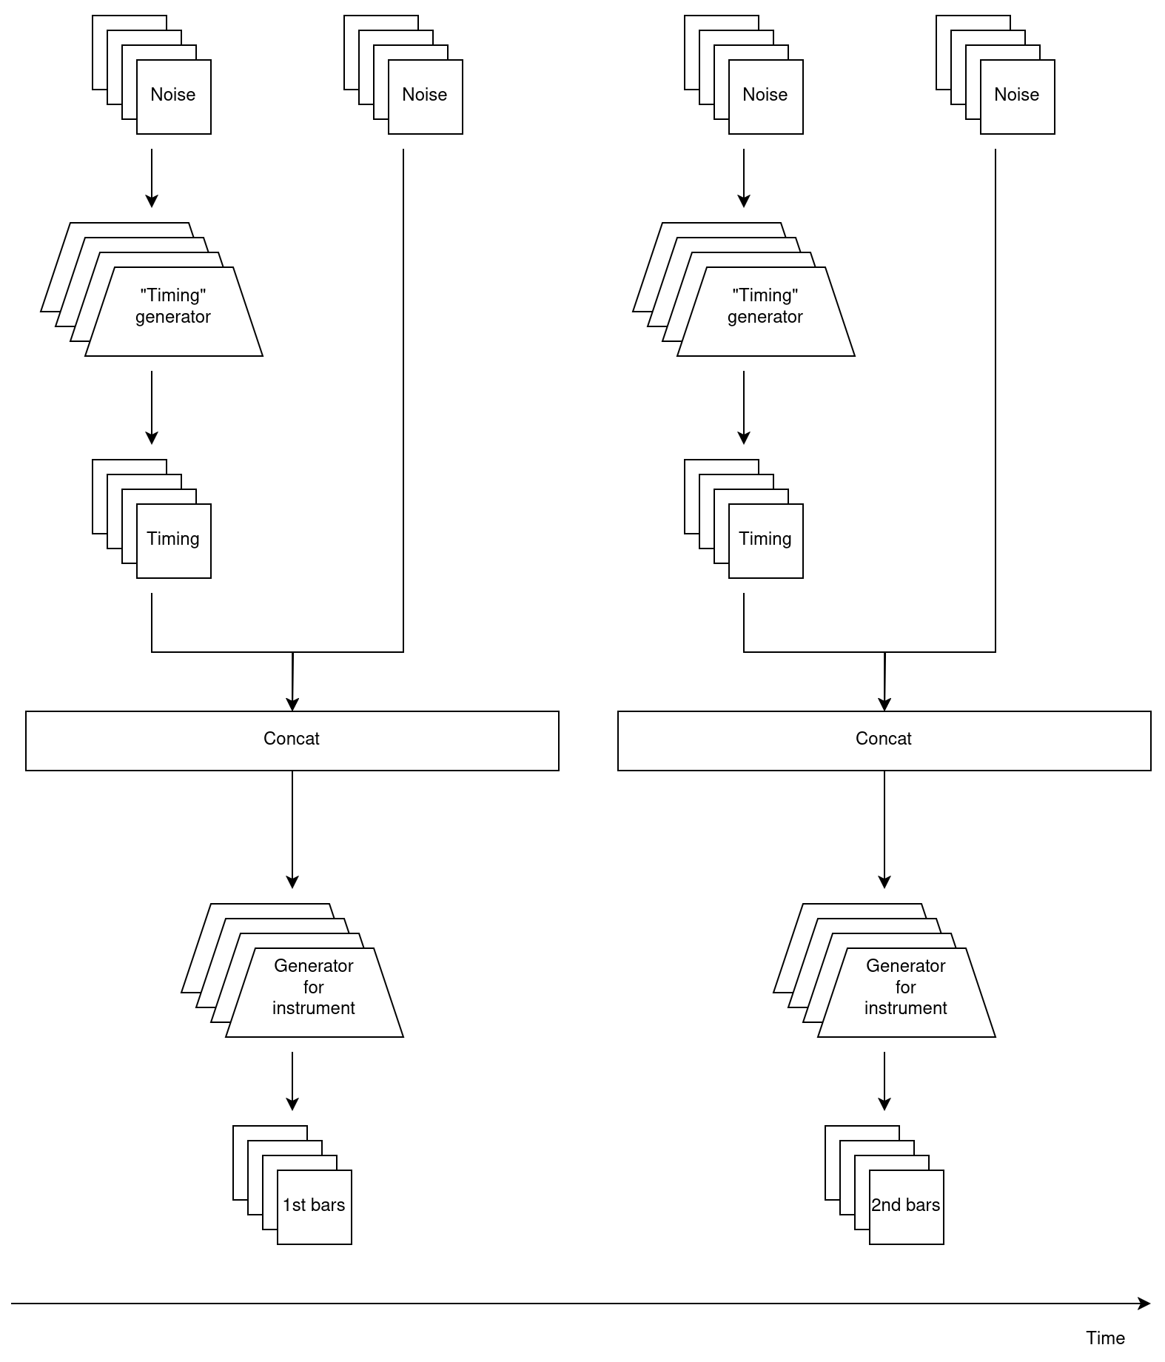
MuseGAN
Each generator must generate a bar for the instrument it was trained on
After the bars are generated, the process is repeated
The generator is trained once every 5 discriminator updates

Slide 22
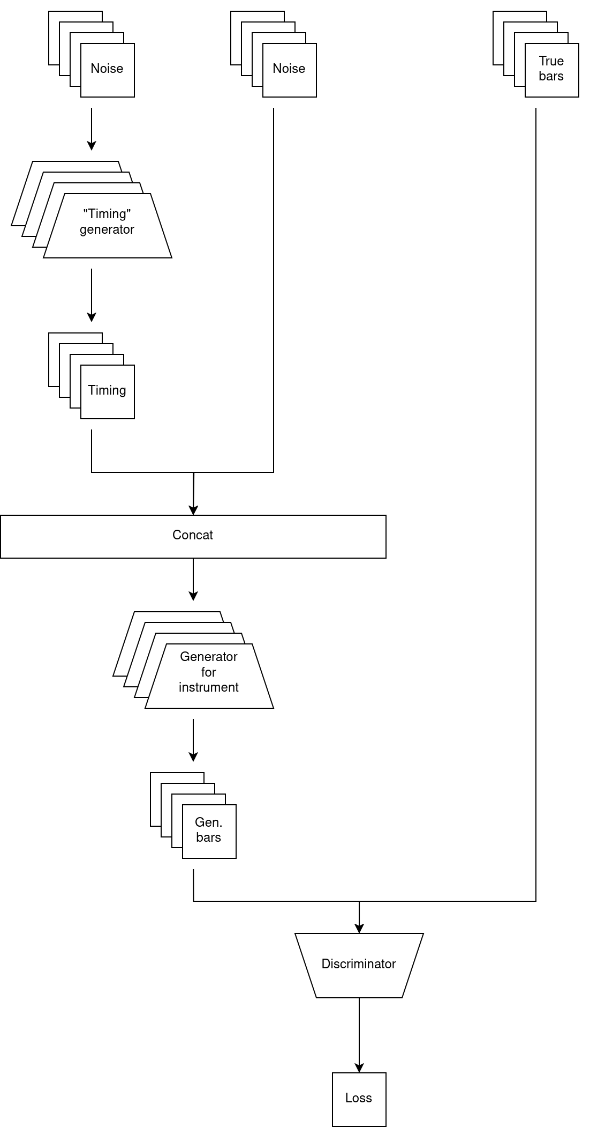
MuseGAN
Discriminators are trained 5 times more than the generators. This is done in order to:
  Prevent mode collapse
  Stabilise training
  Ensure that the discriminator provides meaningful gradients to the generator
The paper proposed using only a single discriminator, regardless of the number of generators
  This is in order to generalise better

Slide 23
MuseGAN
Advantages
Produces coherent, mult-track musical pieces
The outputs can easily be interpreted by humans and machines alike
Disadvantages
Complex
High computation cost
Can produce only a limited amount of musical pieces (inherited from GANs)

Slide 24
Music Transformer
Architecture: Transformers, using Relative Local Attention
Priming data: A sequence of tokens
Example: Time shift, velocity, first note
Output data: MIDIs

Slide 25
Music Transformer
The authors observed that scales, arpeggios and other motifs express a grammar specific to a song or genre, and are recurrent periodically
This observation consists the motivation Relative Local Attention was used, as it could capture these relationships

Slide 26
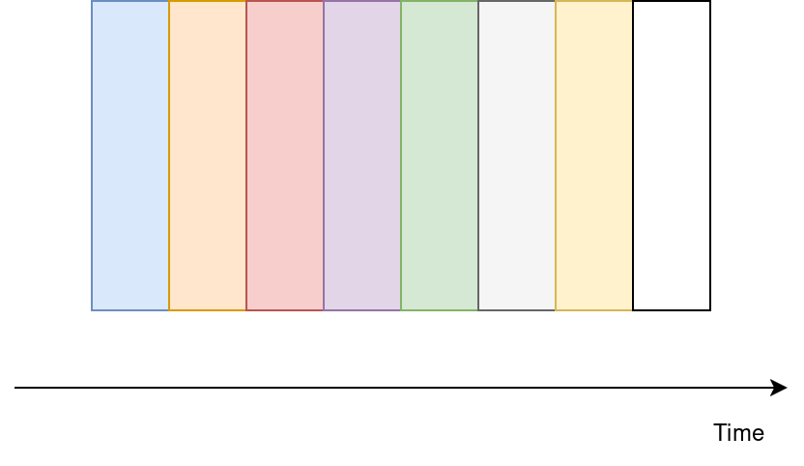
Music Transformer
The authors took a language-modelling approach for the symbolic data representation
Thus the data is expressed a sequence of tokens

Slide 27
Music Transformer
After the MIDIs are converted into discrete token sequences, the model is trained to predict the next token, given previous tokens
Thus, the training process is similar to GPTs

Slide 28
Music Transformer
Advantages
The context-window is large
Training is faster compared to a GAN
Good generalisation
Disadvantages
Works with symbolic data rather than waveforms
Implementation complexity

Slide 29
Jukebox
Architecture: VAE, 1D CNNs for encoders, Transformers for decoders
Priming data: A start token, followed by embeddings
Example: <START>, then genre, artist, timing
Output data: Waveforms

Slide 30
Jukebox
The audio data:
  Is standardized to 32 bits floats, and resampled to 44.1 kHz
  Then it is converted to values between [-1, 1]
  Then it is randomly augmented by converting to mono, either by selecting one channel, or averaging the two channels
  Then it is split into 9-second segments, with overapping or non-overlapping chunks
The text:
  Is converted into text embeddings, similar to other language models

Slide 31
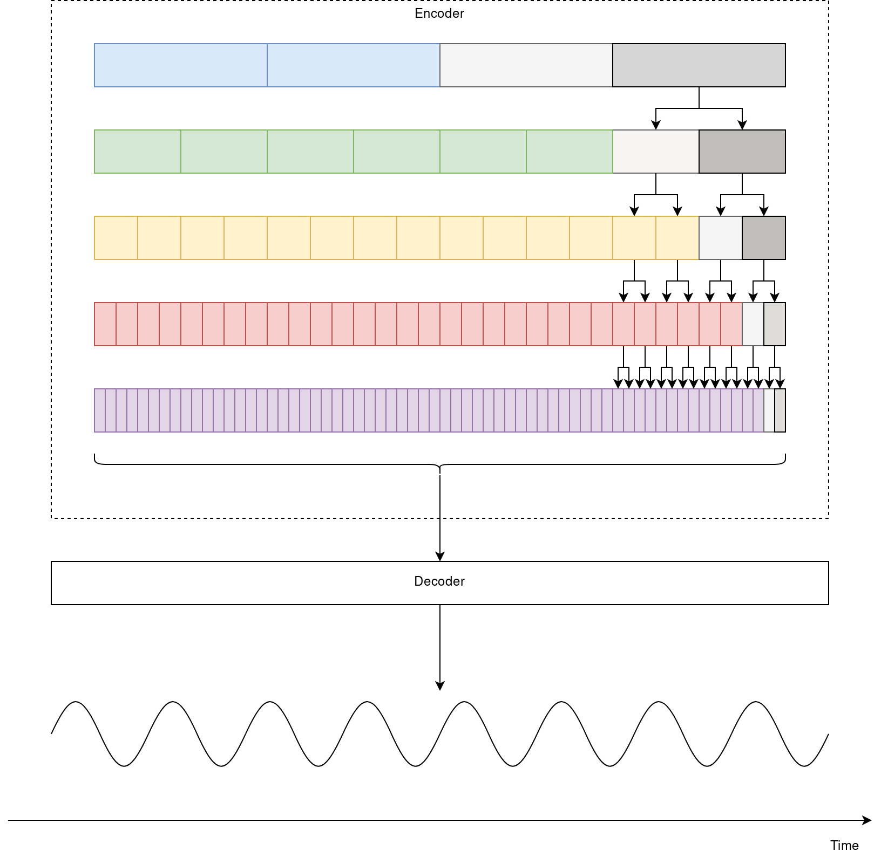
Jukebox
Multiple encoders are trained at different hop lengths
After each encoder generates its output, it is given to the encoders below them:
  The first encoder produces “coarse” tokens for the next encoder
  The next encoders upsamples the tokens upsamples the tokens (green, yellow, red)
  The last encoder upsamples the tokens further, producing “fine-grained” tokens
The tokens from the last encoder are given to the decoder, which produces high-fidelity audio

Slide 32
Jukebox
In order to prevent the model to map most of the latent space to only a few codebook embeddings (codebook collapse), the authors chose to randomly restart the embeddings.
The restart is performed once the mean usage of a codebook vector falls below a threshold

Slide 33
Jukebox
Training was performed:
  On 512 V100s for 4 weeks
  Using Adam optimiser
Evaluation metrics:
  Perplexity
  Musicality
  Coherence
  Spectral convergence
  Codebook utilisation
  Human rating

Slide 34
Jukebox
Advantages
Produces waveforms directly
Produces high-quality audio
Takes text as inputs
Allows for flexible conditioning
Example: genre, artist
Disadvantages
Highly-complex
Slow and immensely expensive to train, option being open only to few
Slow to infer
Struggles with blending genres

Slide 35
JEN
Architecture: VAE, built with Attention blocks and 1D CNNs, in the shape of a U-Net
Priming data: Text embeddings
Example: Text embeddings for “Blues song in the style of Robert Johnson”
Output data: Waveforms

Slide 36
JEN
The paper aims to use image diffusion to generate both autoregressively and non-autoregressively
This is done in order to improve the generation speed, while also learning the sequential structure of the data

Slide 37
JEN
In order for the model to be both autoregressive and non-autoregressive, a multi-task training stategy was applied:
  Text-guided Music Generation: The entire song is masked with Gaussian Noise
  Music In-Painting: Parts of the song are masked with Gaussian Noise
  Music Continuation: The end of the song is masked with Gaussian noise
Two modes are integrated:
  Unidirectional: To gather sequential dependency
  Bidirectional: To gather comprehensive context

Slide 38
JEN
Training was performed:
  On 8 x A100s for 200k steps, on a dataset of 5000 hours of high-quality private music data
  Using AdamW optimizer
Evaluation metrics:
  Perplexity
  Fréchet Audio Distance
  Kullback-Leibler Divergence
  CLAP Score, using a pre-trained CLAP model
  Human rating

Slide 39
JEN
Advantages
High-fidelity audio generation
More efficient than MuseGAN, Jukebox
Strong text-music alignment
The architecture is efficient
Disadvantages
Partially trained on proprietary datasets
The paper has some gaps with respect to zero-shot generation, as it is not shown in the metrics
Inference is not that fast

Slide 40
Proposed solution

Slide 41
Proposed solution
Architecture: Diffusion, built with Attention blocks
Priming data: A start token, followed by text embeddings
Example: <START>, then genre, artist, timing
Output data: Spectrograms, which can be converted to music

Slide 42
Proposed solution
The dataset will consist of 1113 copyright-free musical pieces with textual descriptions, from HuggingFace
The audio data will be transformed:
  Into spectrograms
  Then into tokens
The textual data will be transformed into text embeddings

Slide 43
Proposed solution
Two modes of generation:
Filling: Pieces of the spectrogram will be randomly masked with Gaussian noise
Continuation: Gaussian noise is added at the end of the spectrogram
For each mode, the model must remove the noise.

Slide 44
Proposed solution
In order to mitigate conversion loss between spectrograms and waveforms, the loss from conversion will also be considered during training

Slide 45
Proposed solution
Proposed experiments:
Try to mask different parts of the spectrograms, similar to JEN
Try to use relative positioning, along with absolute positioning, similar to Music Transformer
Investigate with different hop lengths, similar to Jukebox

Slide 46
Thank you!

